Slide 1

Spring introduction

Slide 2
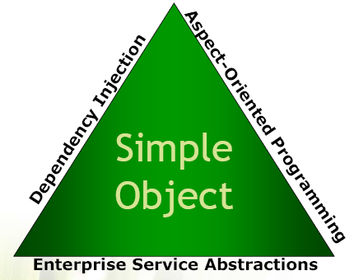
What is the Spring Framework?
The Spring Framework is an open source application framework and inversion of control container for the Java platform.
The framework was first released under the Apache 2.0 license in June 2003.
The current release version is Spring Framework 5.2, which was released in September 2019.
The goal of Spring Framework is to provide comprehensive infrastructural support for developing enterprise Java applications, more exact, Spring deals with the pluming so you can focus on solving the domain problem.
Spring triangle:
- dependency injection – the application context drives bean
configuration
- aspect oriented programming – dynamic proxies add
behavior to the beans
- enterprise service abstractions – Spring can integrate many
enterprise behaviors

Slide 3
Dependency injection
Any nontrivial application (pretty much anything more complex than a Hello World example) is made up of two or more classes that collaborate with each other to perform some business logic. Traditionally, each object is responsible for obtaining its own references to the objects it collaborates with (its dependencies). This can lead to highly coupled and hard-to-test code. With DI, objects are given their dependencies at creation time by some third party that coordinates each object in the system. Objects aren’t expected to create or obtain their dependencies. (source: Spring in Action, 4th Edition, Craig Walls)
Dependency injection is a pattern through which to implement IoC, where the control being inverted is the setting of object's dependencies.
package test; public class HunterElf { private HunterSkillSet hunterSkillSet; public HunterElf() { this.hunterSkillSet = new HunterSkillSet(); } public void useSkill(String skillName) { hunterSkillSet.useSkill(skillName); } } | package test; public class Elf { private SkillSet skillSet; public Elf(SkillSet skillSet) { this.skillSet = skillSet; } public void useSkill(String skillName) { skillSet.useSkill(skillName); } }

Slide 4
Advantages of DI
Your object is handed what it needs to work
simplifies your code, improves code reusability
frees it from the burden of resolving its dependencies
Promotes programming to interfaces
conceals the implementation details of each dependency
Improves testability
Dependencies can be easy stubbed or mocked for unit testing
Allows for centralized control over object lifecycle

Slide 5
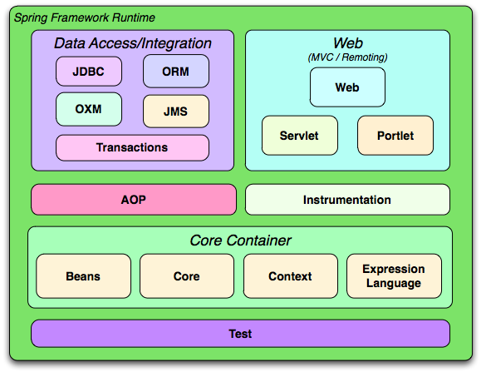
Spring modules
The Spring Framework contains a lot of features, which are well-organized in about twenty modules. These modules can be grouped together based on their primary features into Core Container, Data Access/Integration, Web, AOP (Aspect Oriented Programming), Instrumentation and Test.
The Core Container consists of the Core, Beans, Context, and Expression Language modules.
The Core and Beans modules provide the fundamental parts
of the framework, including the IoC and Dependency Injection features.
The Context module builds on the solid base provided
by the Core and Beans modules. It provides a way to access
objects in a framework-style manner in a fashion somewhat
reminiscent of a JNDI-registry. The Context module inherits its
features from the Beans module and adds support for
internationalization (I18N) (using for example resource bundles),
event-propagation, resource-loading, etc. The ApplicationContext
interface is the focal point of the Context module that provides these features.
The Expression Language module provides
a powerful expression language for querying and
manipulating an object graph at runtime.

Slide 6
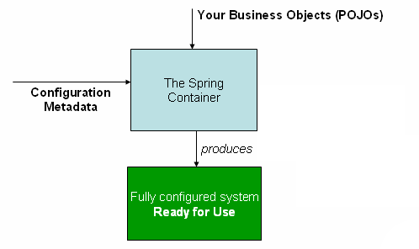
Container overview
The diagram is a high-level view of how Spring works.
As the diagram shows, the Spring IoC container consumes
a form of configuration metadata; this configuration
metadata represents how you as an application developer
tell the Spring container to instantiate, configure, and
assemble the objects in your application.
Configuration metadata is supplied in one of 3 ways:
XML-based Configuration : All configurations are in one or multiple XML files. This is the most verbose way of configuration. Huge projects require tedious amount of XML which is difficult to manage.
Annotation-based configuration : Spring 2.5 introduces annotation-based configuration. We still have to write XML files but just to indicate "component-scan" on the packages of annotated classes.
Java-based configuration (JavaConfig): Starting with Spring 3.0, a pure-Java means of configuring container was provided. We don't need any XML with this method of configuration. JavaConfig provides a truly object-oriented mechanism for dependency injection, meaning we can take full advantage of reusability, inheritance and polymorphism in the configuration code. Application developer has complete control over instantiation and dependency injection here.

Slide 7
@Configuration – part I
Introduced by Spring 3.0.
@Configuration classes
must have a default constructor (implicit or not) (tricky, even if you declare your own constructor with parameters it is not used)
multiple configuration classes may exist.
@Import annotation can be used to import other configuration classes
@Bean methods
must not be private
method name becomes the bean id
beans are singleton but @Scope annotation can be used to change scope
can call any code you want, not just constructor and setters
@Configuration
public class AppConfig {
@Bean
public SimpleService simpleService() {
SimpleService simpleService = new SimpleServiceImpl(); simpleService.setSimpleDao(simpleDao());
return simpleService;
}
@Bean public SimpleDao simpleDao() { return new SimpleDaoImpl();}}

Slide 8
@Configuration – part II
@Configuration public class ServiceConfig {
@Autowired private AccountRepository accountRepository;
@Bean public TransferService transferService() {
return new TransferServiceImpl(accountRepository);
}
}
@Configuration public class RepositoryConfig {
@Autowired private DataSource dataSource;
@Bean public AccountRepository accountRepository() {
return new JdbcAccountRepository(dataSource);
}
}
@Configuration
@Import({ServiceConfig.class, RepositoryConfig.class})
public class SystemConfig {
@Bean public DataSource dataSource() {
return new DataSource();
}
}
public static void main(String[] args) {
ApplicationContext ctx = new AnnotationConfigApplicationContext(SystemConfig.class);
// everything wires up across configuration classes...
TransferService transferService = ctx.getBean(TransferService.class);
transferService.transfer(100.00, "A123", "C456");
}

Slide 9
Stereotype annotations
Spring framework stereotype annotations
@Component is a generic stereotype for any Spring-managed component
@Repository annotation is a marker for any class that fulfills the role or stereotype (also known as Data Access Object or DAO) of a repository
@Service for service classes
@Controller for controller classes
@Configuration for Java Configuration classes
@Service
public class ServiceImpl implements Service {
private Repository repository;
@Autowired
public ServiceImpl(Repository repository) {
this.repository = repository;
}}

Slide 10
Component scanning
Base-package and sub-packages of base-package scanned at startup
All classes annotated with @Component (but also with @Repository, @Service, @Controller and @Configuration) are loaded.
Component names when are not specified are auto-generated with default value of de-capitalized class name.
Recommendation: avoid using names when possible, in many cases you don’t have two implementations of the same bean in the ApplicationContext. Specifying names is less refactoring-friendly.
Jar dependencies are also scanned
Scanning could result in slower startup time if too many files are scanned.
Best practices:
Really bad: <context: component-scan base-package=“org, com” />
Bad: <context: component-scan base-package=“com” />
Ok: <context: component-scan base-package=“com.endava.app” />
Optimized: <context: component-scan base-package=“com.endava.app.repository, com.endava.app.service, com.endava.app.controller” />
The possibility to include or exclude beans exist by using filters on type or class-level annotation.

Slide 11
Summary
Spring manages the lifecycle of the application; all beans are initialized before they are used.
Beans are always created in the right order, based on their dependencies.
Each bean is bound to a unique id.
The Application Context works as a container, encapsulating the bean implementations chosen for a given deployment.

Slide 12
Constructor dependency injection
Constructor-based DI is accomplished by the container invoking a constructor with a number of arguments, each representing a dependency.
<bean id="service" class="ro.endava.s.c.app.service.ServiceImpl">
<constructor-arg ref="repository"/>
</bean>
<bean id="repository" class="ro.e.s.c.app.repository.RepositoryImpl"/>
Equivalent to:
RepositoryImpl repository = new RepositoryImpl();
ServiceImpl service = new ServiceImpl(repository);
Application Context
service -> instance of ServiceImpl
repository -> instance of RepositoryImpl

Slide 13
Setter dependency injection
Setter-based DI is accomplished by the container calling setter methods on your beans after invoking a no-argument constructor or no-argument static factory method to instantiate your bean.
<bean id="service" class="ro.endava.s.c.app.service.ServiceImpl">
<property name="repository" ref="repository"/>
</bean>
<bean id="repository" class="ro.e.s.c.app.repository.RepositoryImpl“/>
Equivalent to:
RepositoryImpl repository = new RepositoryImpl();
ServiceImpl service = new ServiceImpl();
service.setRepository(repository);
Application Context
service -> instance of ServiceImpl
repository -> instance of RepositoryImpl

Slide 14
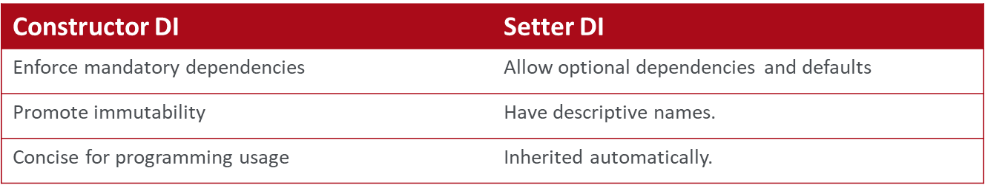
Setter VS constructor DI
Since you can mix both, Constructor- and Setter-based DI, it is a good rule of thumb to use constructor arguments for mandatory dependencies and setters for optional dependencies.
<bean id="service" class="ro.endava.spring.core.app.service.ServiceImpl">
<constructor-arg ref="required"/>
<property name="optional" ref="optional" />
</bean>
<bean id=" required " class="ro.endava.s.c.app.collaborator.RequiredImpl">
<bean id= “optional" class="ro.endava.s.c.app.collaborator.OptionalImpl">
The Spring team generally advocates setter injection, because large numbers of constructor arguments can get unwieldy, especially when properties are optional.
The most important thing is to be consistent.

Slide 15
@Autowired – part I
@Autowired indicates that Spring should inject a dependency:
- based on its type
- based on its name when @Qualifier notation is used
XML based dependency injection
<bean id="service" class="r.e.s.c.app.service.ServiceImpl">
<constructor-arg ref="repository"/>
</bean>
Annotation based dependency injection
@Component
public class ServiceImpl implements Service {
private Repository repository;
@Autowired
public ServiceImpl(Repository repository) {
this.repository = repository;
}}

Slide 16
@Autowired – part II
constructor injection
public ServiceImpl(Repository repository) {
this.repository = repository;
}
method injection
public setRepository(Repository repository) {
this.repository = repository;
}
field injection (no setter is required – reflection is used)
@Autowired
private Repository repository;

Slide 17
@Qualifier
Because autowiring by type may lead to multiple candidates, it is often necessary to have more control over the selection process.
You can associate qualifier values with specific arguments, narrowing the set of type matches so that a specific bean is chosen for each argument.
@Component
public class ServiceImpl implements Service {
@Autowired
@Qualifier ("jdbcRepository")
private Repository repository;
}
@Autowired
Private JdbcRepository repository2;
……….
@Component
public class JdbcRepository implements Repository {…}
@Component
public class MyBatisRepository implements Repository {…}

Slide 18
@Value
Use @Value for Spring Expression Language expressions in Java code on a field or method or on a parameter of autowired method or constructor
<context:property-placeholder location="classpath:config.properties" />
Jdbc:
url:
aDefaultUrl: https://jbdgkdnkfdf
@Component
public class FieldValueTestBean {
@Value("${jdbc.url:aDefaultUrl}")
private String url;
}
Or
@Component
public class FieldValueTestBean {
private String url;
@Value("${jdbc.url}")
public void setUrl(String url) {
this.url = url;
}
}
Or
@Component
public class FieldValueTestBean {
private String url;
public FieldValueTestBean(@Value("${jdbc.url}") String url){
this.url = url;
}
}

Slide 19
Application lifecycle
Initialization → | Use → | Destruction
Preparing Application services are created and configured Application is not usable until this phase is complete | Used by clients Application services process client requests 99.99% of the time is spent in this phase (hopefully) | Shuts down Application services release any system resources
This lifecycle applies to any class of the application
Standalone Java Application
Junit System Test
Java EE web application
Java EE enterprise application
Spring fits in to manage application lifecycle
Plays an important role in all phases
Lifecycle is the same in all these configurations
Consistent behavior

Slide 20
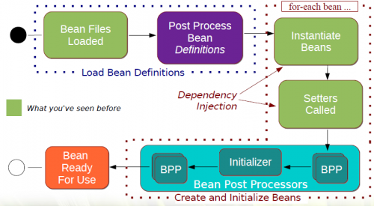
Bean initialization steps
The XML files/configurations are parsed.
Bean definitions are loaded in the context, each bean is indexed under its id.
Special BeanFactoryPostProcessor beans are invoked, which can modify the definition of any bean.

Slide 21
Bean scoping
When you create a bean definition, you create a recipe for creating actual instances of the class defined by that bean definition. The idea that a bean definition is a recipe is important, because it means that, as with a class, you can create many object instances from a single recipe.
Scope | Description
singleton | (Default) Scopes a single bean definition to a single object instance per Spring IoC container.
prototype | Scopes a single bean definition to any number of object instances.
request | Scopes a single bean definition to the lifecycle of a single HTTP request; that is, each HTTP request has its own instance of a bean created off the back of a single bean definition. Only valid in the context of a web-aware Spring ApplicationContext.
session | Scopes a single bean definition to the lifecycle of an HTTP Session. Only valid in the context of a web-aware Spring ApplicationContext.
global session | Scopes a single bean definition to the lifecycle of a global HTTP Session. Typically only valid when used in a portlet context. Only valid in the context of a web-aware Spring ApplicationContext.

Slide 22
Bean inheritance
Don’t repeat yourself, use bean inheritance if you are seeing repetitive XML
<beans>
<bean id="defaultConnection" class="…" abstract="true">
<property name="username" value="username" />
<property name="password" value="password" />
</bean>
<bean id=“connection-A" parent="defaultConnection">
<!– property username is inherited -->
<!– property password is inherited -->
</bean>
<bean id=“connection-B" parent="defaultConnection">
<property name="username" value="usernameB" />
<!– property password is inherited -->
</bean>
<bean id=“connection-C" parent="defaultConnection">
<property name="username" value="usernameC" />
<!– property password is inherited -->
</bean>
</beans>

